Slide 1
The Relational Model
COMP / IT 420 Lecture 3
February 8th, 2021

Slide 2
Overview
Project group assignments
Lecture
Modeling and Abstraction
Relational Model
MySQL Specifics (Will extend to Lab most likely)

Slide 3
HW1 Due Tuesday 2/16 at 11:59pm
3

Slide 4
Objectives
Layers of Modeling
Relations (aka Tables)
Keys (Primary, Foreign)
Relational Algebra (Intro to SQL)
Data Dictionary (power of metadata)
MySQL Details

Slide 5
Conceptual or Logical Model
An abstraction of the physical database.
Macro-level view of data environment
Basis for the identification and high-level description of the main data objects
Software and hardware independent

Slide 6
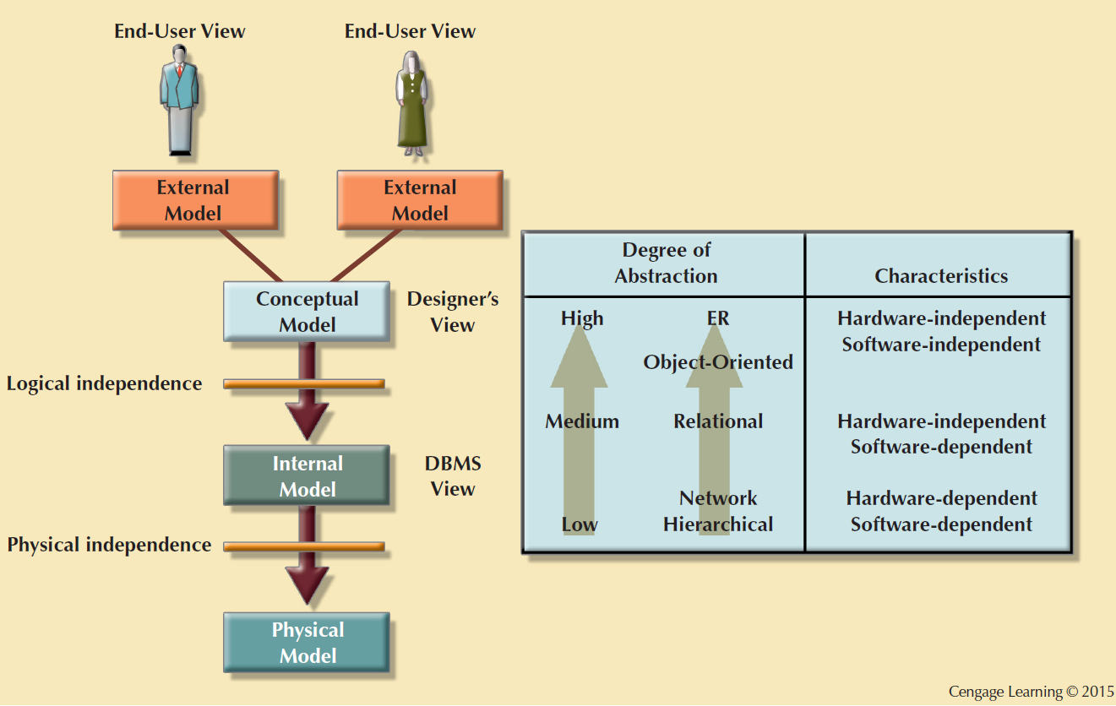
6

Slide 7
The Internal Model
Mapping conceptual model to the logical model of DBMS
Relational model separates physical / logical structure
Internal schema: Specific representation of an internal model
Uses the database constructs supported by the chosen database
Is software dependent and hardware independent
Logical independence: Changing internal model without affecting the conceptual model

Slide 8
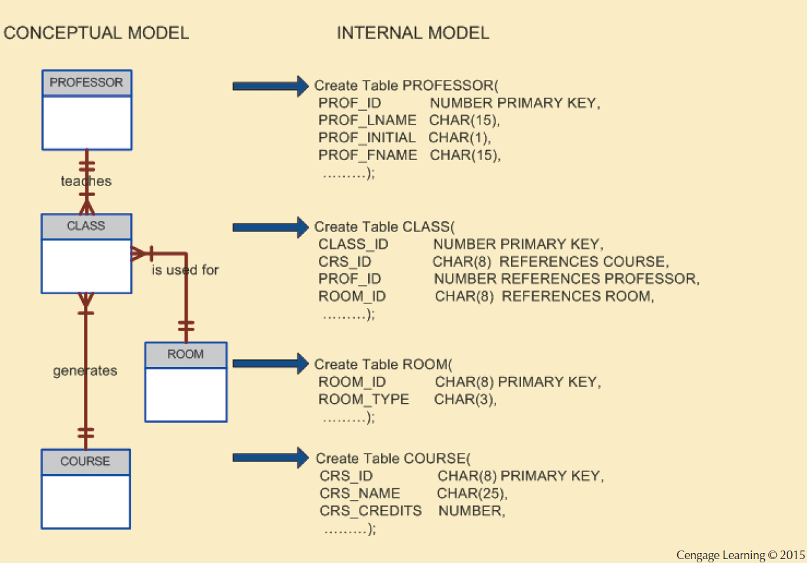
8

Slide 9
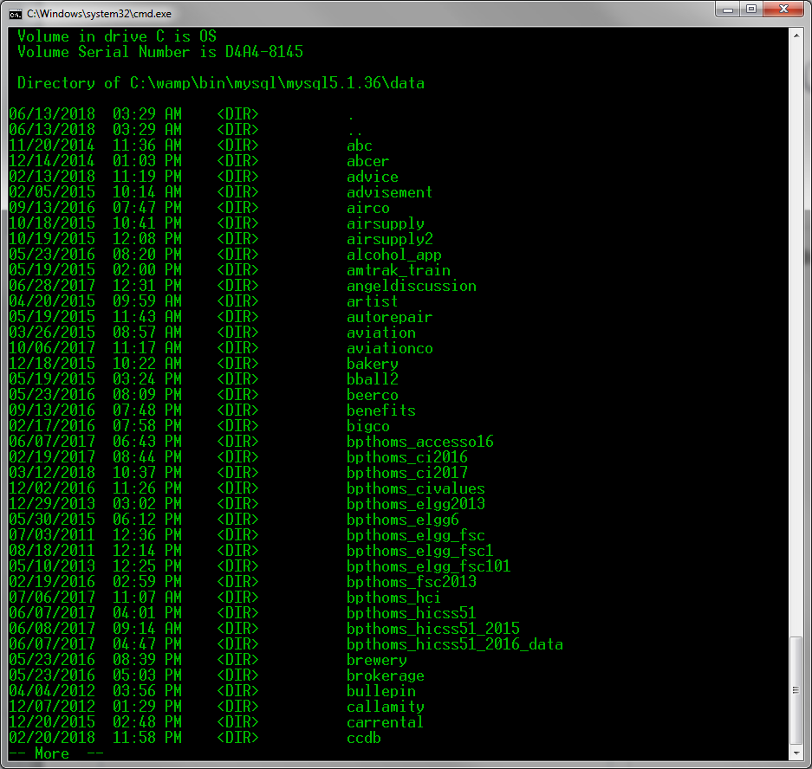
The Physical Model
Lowest level of abstraction
Describes how data persists on storage media
Requires the definition of physical storage and data access methods
Relational model does not require physical-level details
Physical independence: Changes in physical model do not affect internal model
9

Slide 10
A Relation (aka table, file, entity set)
Puts the relation in relational databases.
Persistent representation of an entity.
Groups related entity occurrences (instances of an entity)
Relation in relational model is NOT a relationship
File system terminology is still pervasive in industry
10

Slide 11
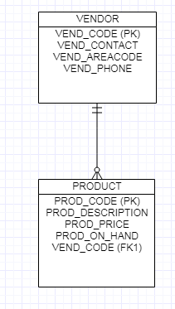
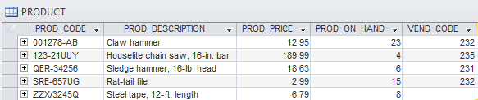
A Relation (aka table, file)

Slide 12
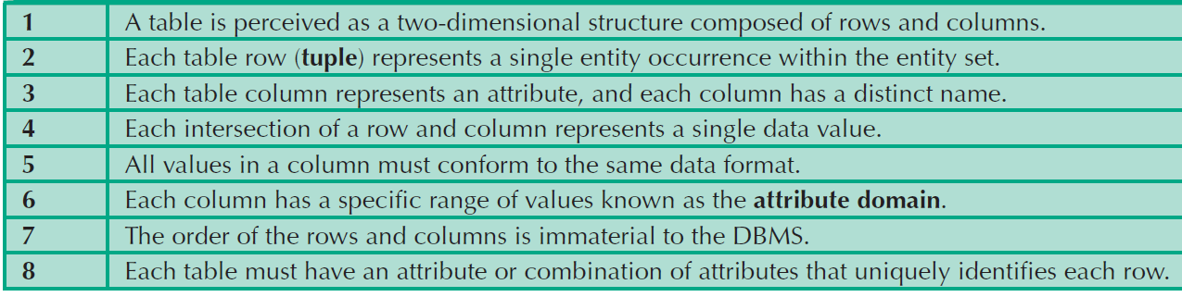
Characteristics of a Relational Table
1
2
3
4
5
6
7
8
12

Slide 13

NULL Keyword
Meet Slash
When the intersection of a row and column does not contain data
Possibly reasons:
An unknown attribute value
A known, but missing, attribute value
A inapplicable condition (middle name/initial)
NOT NULL constraints enforce required data.
EID | FNAME | LNAME | ADDRESS
000001032 | Nfn | Slash | 388 Greenwich St. NY,NY10013
13

Slide 14

Functional Dependence
Determination: Knowing one attribute determines the value of another attribute
Determinant: Attribute whose value determines another
DolphinId can determine student info including address information.
Dependent: Attribute whose value is determined by the other attribute
Student Name (FNAME + LNAME) or Address (STREET + APT + CITY + STATE + ZIP) is determined by DolphinId.
14

Slide 15
Functional Dependence
STU_DOLPHIN_ID -> STU_LNAME
Determinant
Dependent

Slide 16
Key
A field or group of characters within a record that identifies the record, establishing its position among sorted records, and/or provides information about its contents.
One or more attributes that determine other attributes
16

Slide 17
Primary Key (PK)
A designated attribute or combination of attributes that uniquely identifies an entity instance.
STUDENT?
Dolphin ID but not SSN
Sensitive PII
CAR?
VIN but not License Plate (Why?)
TWITTER?
Handle but not display name.
17

Slide 18
More Key Terms
Natural Key
generally accepted identifier used to distinguish an object
Surrogate Key
a system assigned identifier used as a primary key
SSN vs. DolphinID
Composite Key (Identifier)
primary key composed of multiple sub-components
18

Slide 19
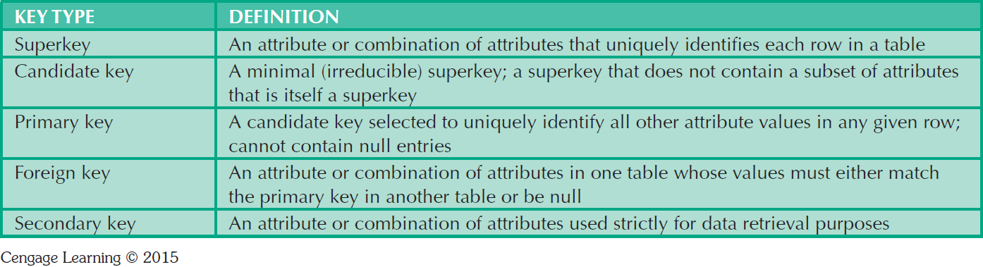
Is a social security number a [super, candidate, primary, foreign, secondary] key?
A primary distinction between candidate and primary key is done for DB optimization and searching and sometimes security (e.g. SSN vs. DolphinId).
19

Slide 20
Entity Integrity
A Primary Key ensures entity integrity or a record’s uniqueness (a.k.a. First Normal Form or 1NF)
Cannot contain duplicate values
One SSN per U.S. citizen
One DolphinID per student
Cannot contain NULL values
20

Slide 21
Referential Integrity and Foreign Keys
Referential integrity ensures that every reference to an entity instance by another entity instance is valid. This includes references to NULL.
A foreign key is a primary key referenced from another table.
Foreign keys enforce referential integrity in relational databases.
21

Slide 22
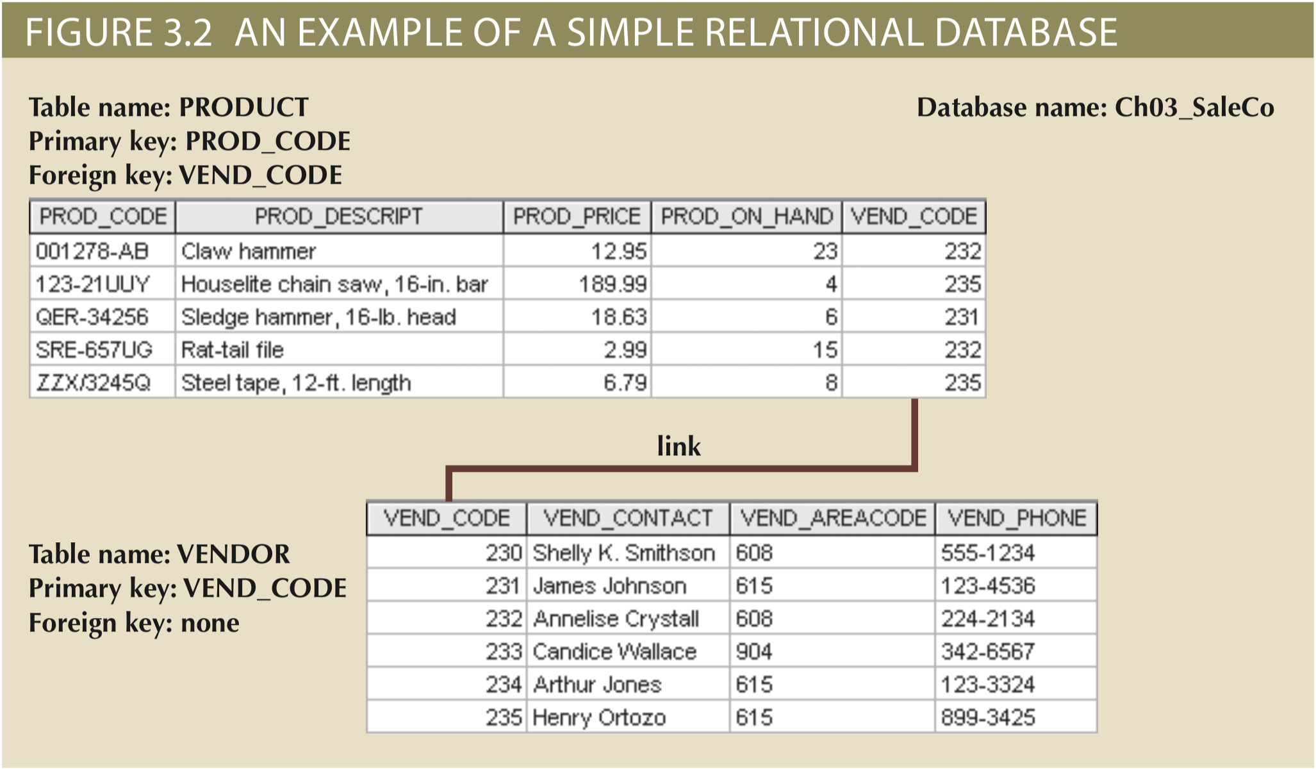
22

Slide 23
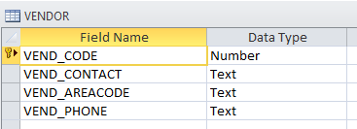
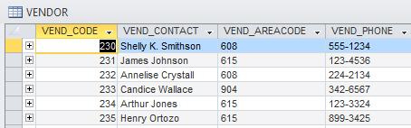
Entity Integrity (PK)
Entity Integrity | Description
Requirement | All primary key entries are unique, and no part of a primary key may be null
Purpose | Entity integrity and all rows are unique
Example | Vendor Code 235 represents Henry Ortozo and only Henry Ortozo
Design: Metadata
Table Data
23

Slide 24
Referential Integrity (FK)
Referential Integrity | Description
Requirement | A foreign key must link with a primary key in another table or be NULL
Purpose | Prevents update anomalies where data in FK-table is modified and no longer matches values in PK-table.
Example | 123-UUY (houselite chainsaw) is sold by a valid vendor in VENDOR (Henry Ortozo).
24

Slide 25
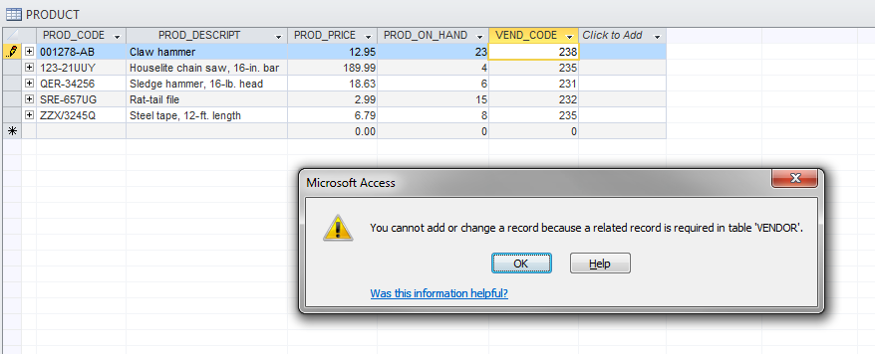
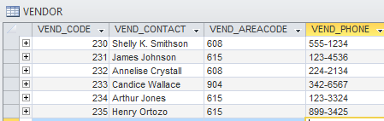
25

Slide 26
Handling NULL Values
Flags: Special codes used to indicate the absence of some value
NOT NULL constraint (NN)
Ensures that every row in a table has a value for that column
Example: FirstName field must be added -> Nfn
UNIQUE constraint (UN)
Ensures that no duplicate values exist for that column
Example: 1 unique DolphinId can register for CSIT 420
26

Slide 27
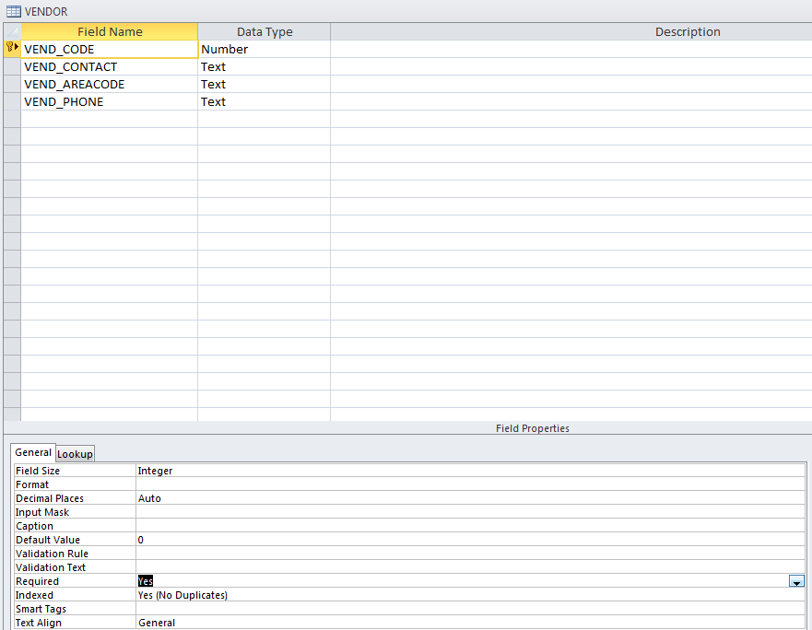
27

Slide 28
Relational Algebra
Theoretical way of manipulating table contents using relational operators (i.e. How to query relations)
Have the property of closure, which means they take input relations and produce output relations
More specifically, it means that the results of an operation are always defined
Different from programming “closure”

Slide 29
Relational Algebra
Select (Restrict)
Unary operator that yields a horizontal subset of a table
Project
Unary operator that yields a vertical subset of a table
Union
Combines all rows from two tables, excluding duplicate rows
Union-compatible: Tables share the same number of columns, and their corresponding columns share compatible domains
Intersect
Yields only the rows that appear in both tables
Tables must be union-compatible to yield valid results
29

Slide 30
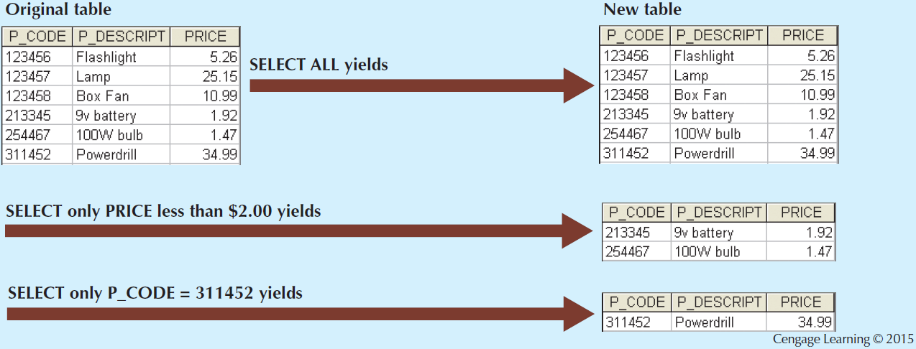
Select (σ)
Horizontal subset
30

Slide 31
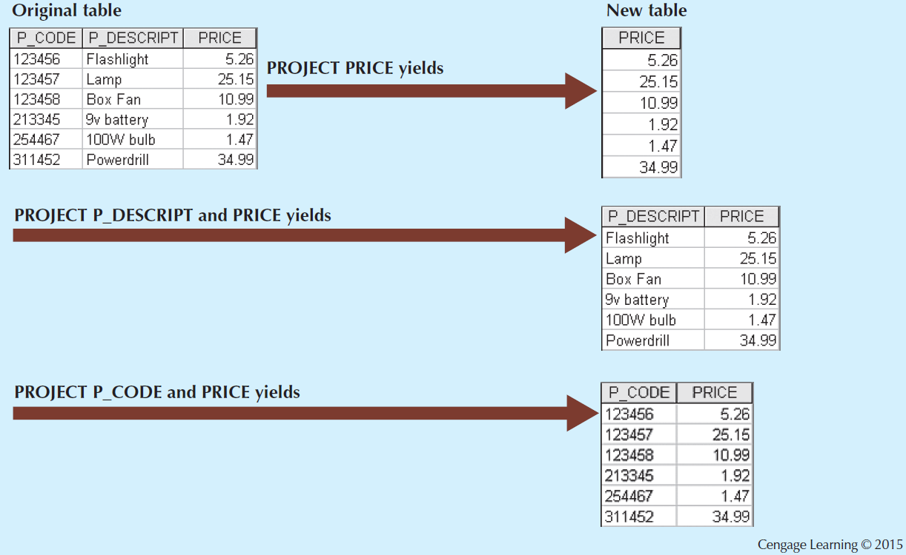

Project ($π$)
Vertical Subset
31

Slide 32
SELECT and PROJECT in SQL
In SQL PROJECT and SELECT are the same combined operation, SELECT.
SELECT *
FROM VendorTbl
WHERE VendorID=123
SELECT VendorFName, VendorLName
FROM VendorTbl
WHERE VendorID=123
32

Slide 33
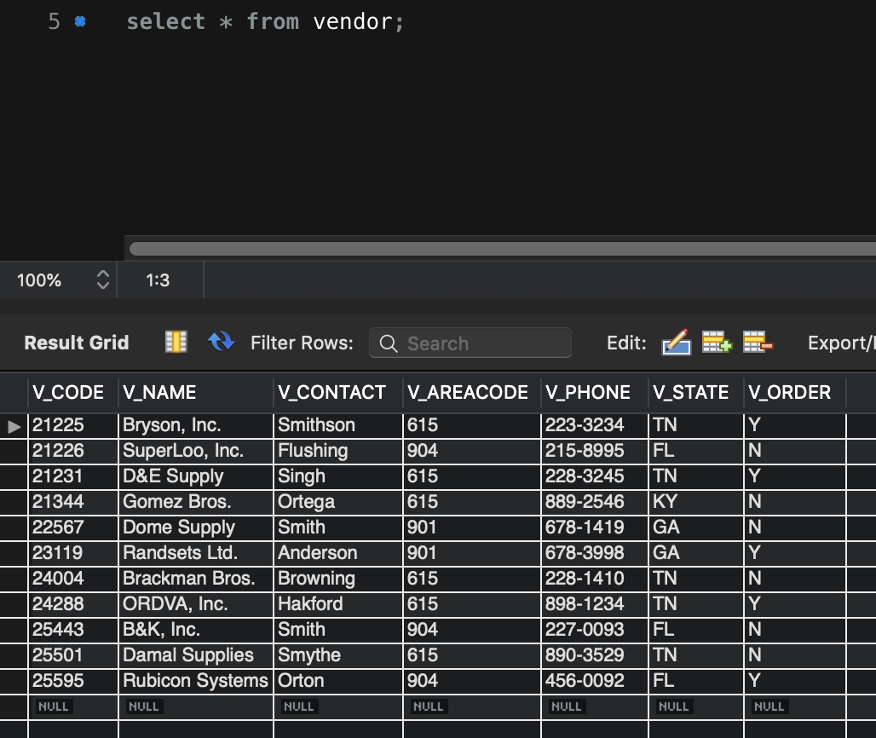
33

Slide 34
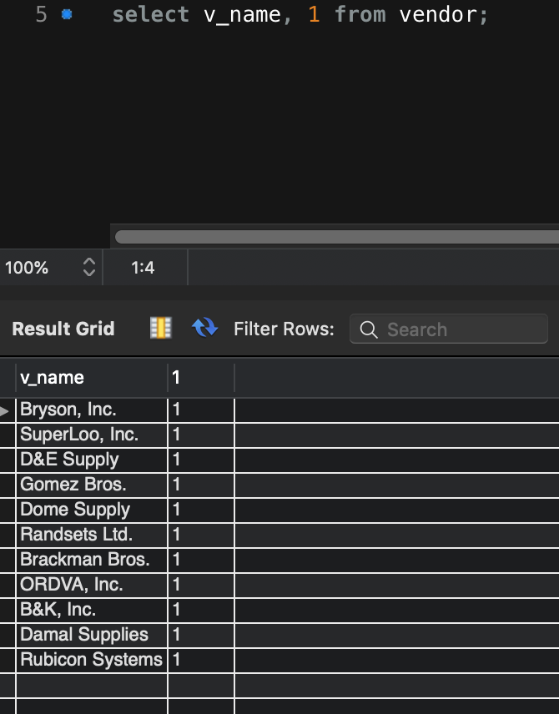
34

Slide 35
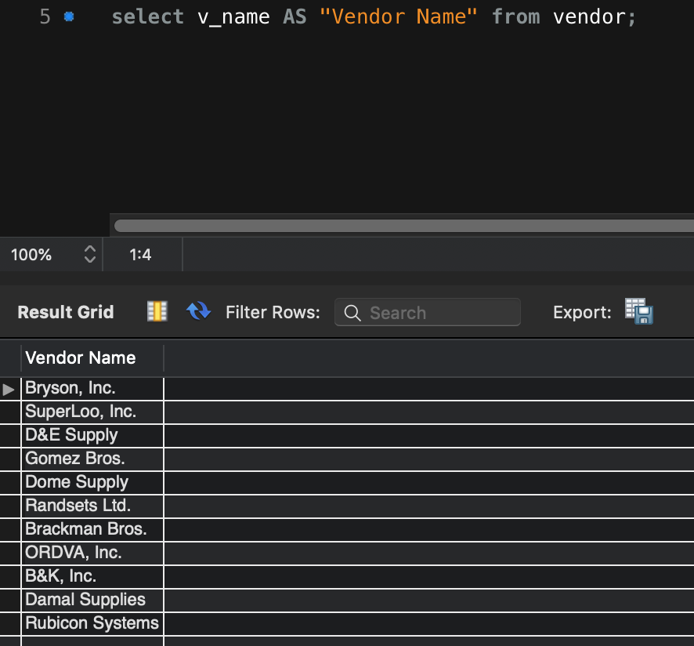
35

Slide 36
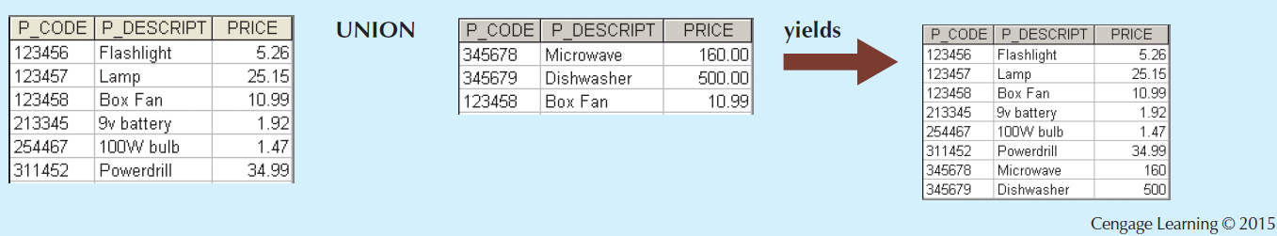
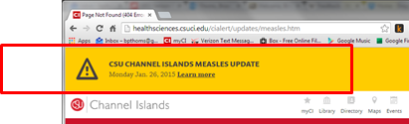
Union (∪, combine tables)
36

Slide 37
Union
Union-compatible, same number of columns with same domains (constraints and datatypes)
πsupplier_name (supplier) ∪ πvendor_name (vendor)

Slide 38
UNION in SQL
SELECT LocationID, DepartmentName
FROM Departments
UNION
SELECT LocationID, WarehouseName
FROM Warehouses;
38

Slide 39
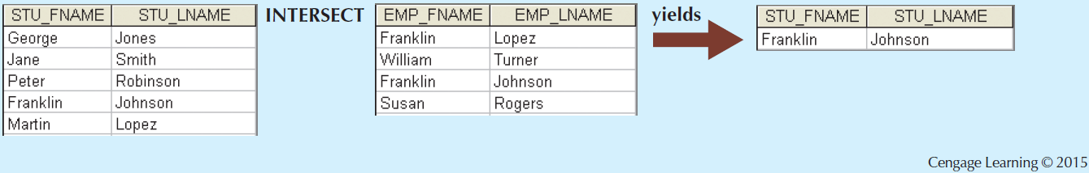
Intersect (∩, match on like data)
39

Slide 40
Relational Set Operators
Difference
Yields all rows in one table that are not found in the other table
Tables must be union-compatible to yield valid results
Not commutative
Table1 – Table2 =\= Table2 – Table1
Product (Cartesian)
Yields all possible pairs of rows from two tables
40

Slide 41
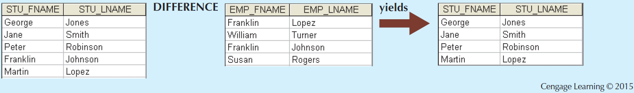
Difference (-)
What happened?
41

Slide 42
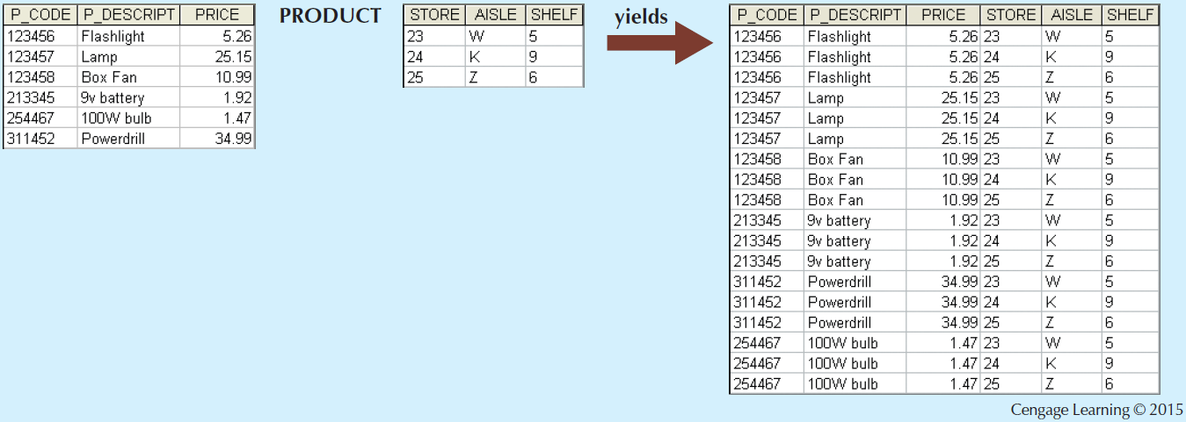
Product (⨯)
Kind of useless, unless you want a dump of all data from each table mapped with all data from another. BUT, important to understand for JOIN operations
42

Slide 43
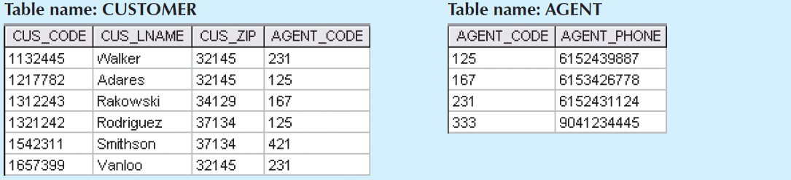
Join
Allows information to be intelligently combined from two or more tables
One of the most important abilities of SQL and RDMBS. Allows data from multiple tables to be combined to form new information.
43

Slide 44
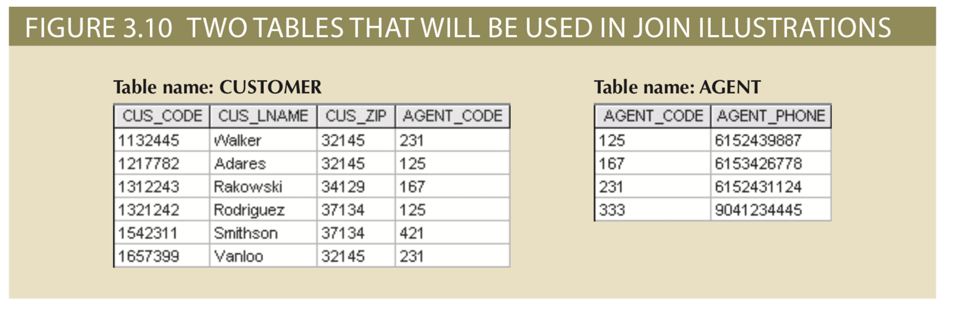
Natural Join Example

Slide 45
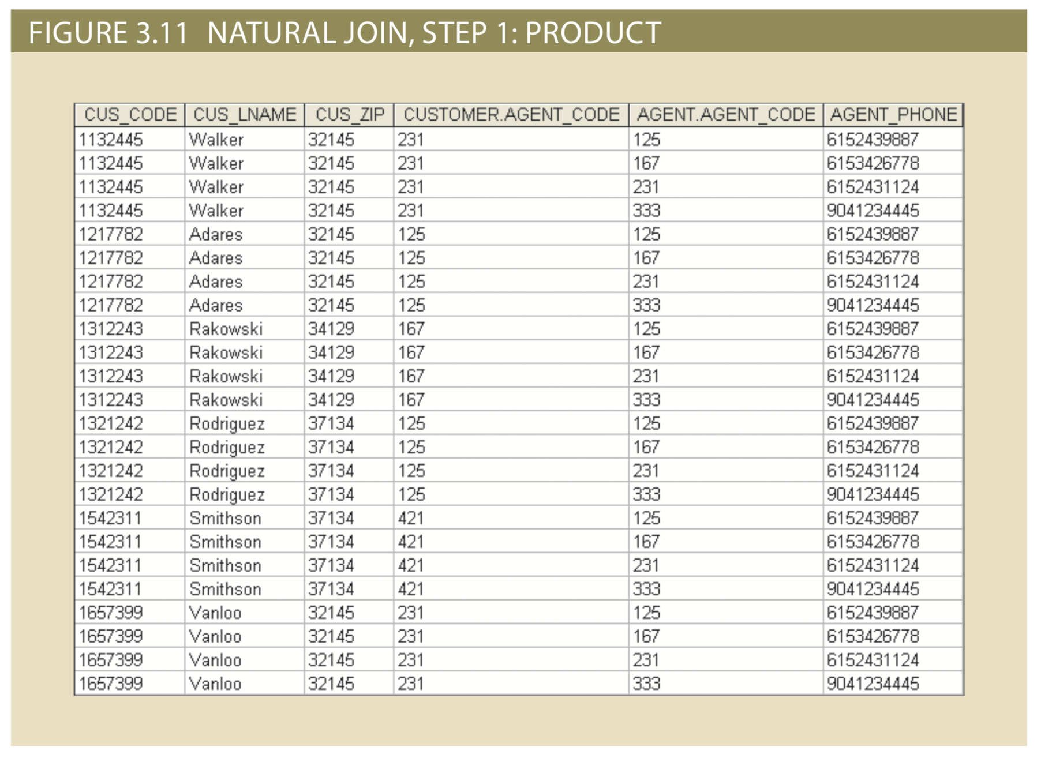
Natural Join Example

Slide 46
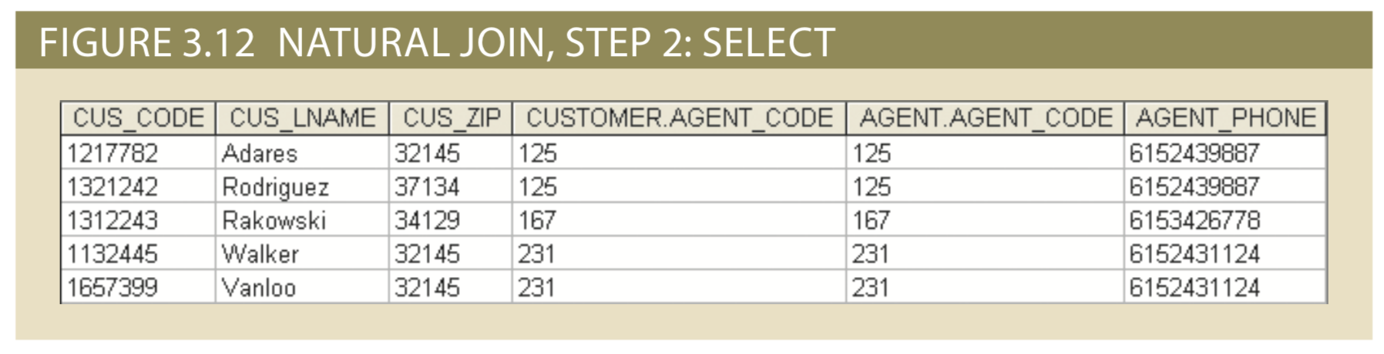
Natural Join
CUSTOMER.AGENT_CODE = AGENT.AGENT_CODE

Slide 47
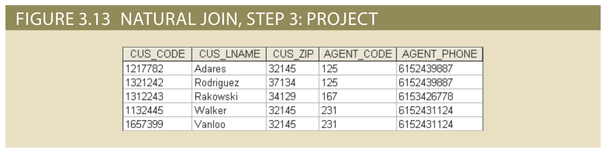
Natural Join (⨝)
π (σ (customer × agent))

Slide 48
Joins in SQL
Attributes
SELECT CUS_LNAME, AGENT_PHONE
FROM CUSTOMER
LEFT JOIN AGENT ON CUSTOMER.AGENT_CODE=AGENT.AGENT_CODE
Tables
Intersection
48

Slide 49
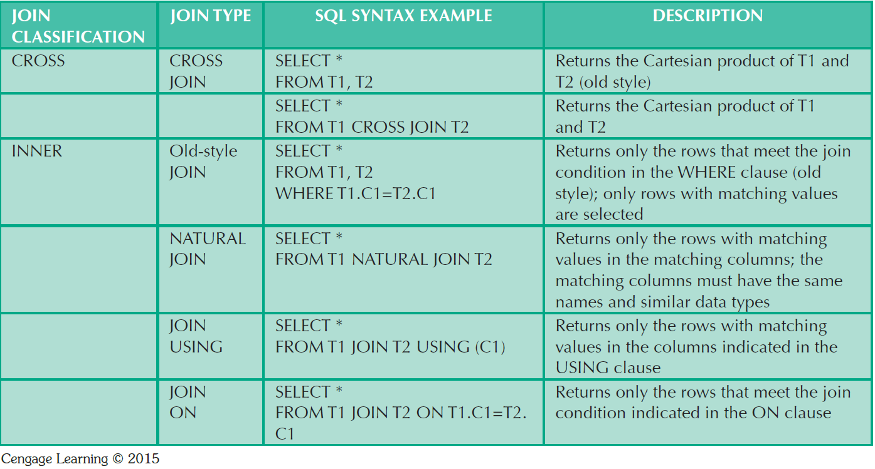
SQL Join Expressions
I’m old ☹
ANSI-89
ANSI-92
49

Slide 50
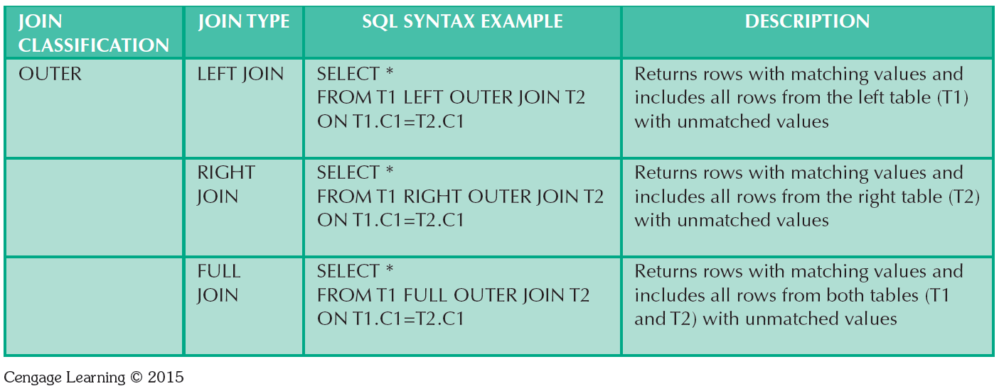
SQL Join Expressions
50

Slide 51

51

Slide 52
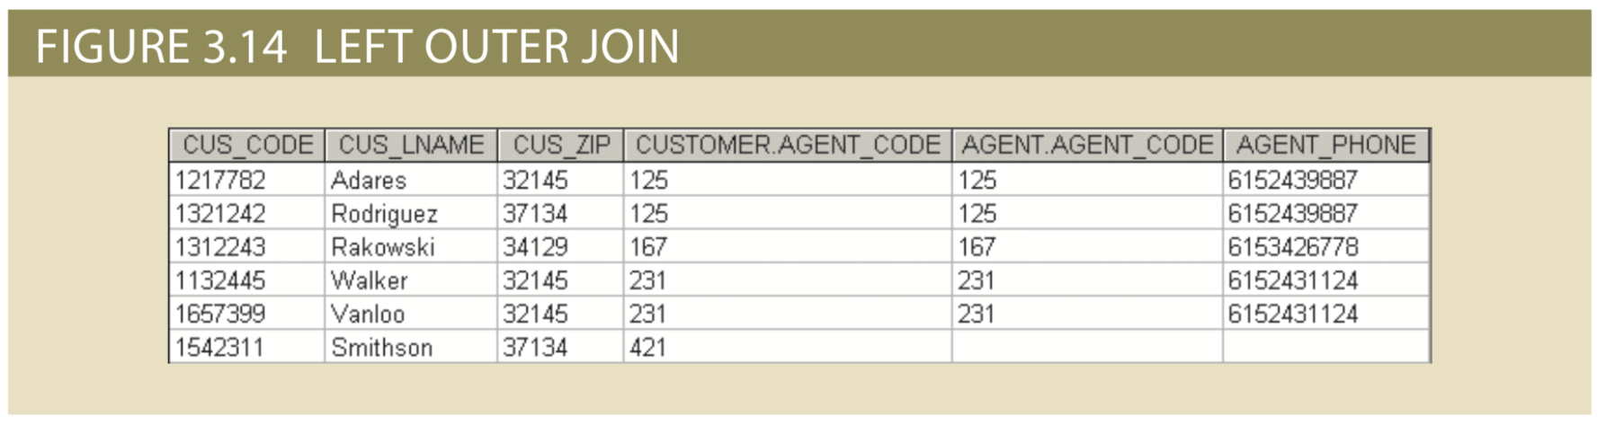
Left Outer Join

Slide 53
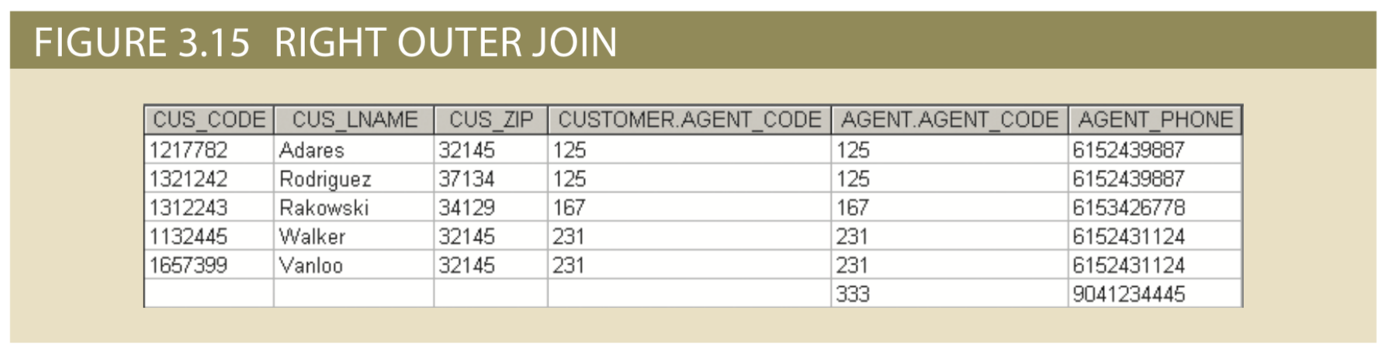
Right Outer Join

Slide 54
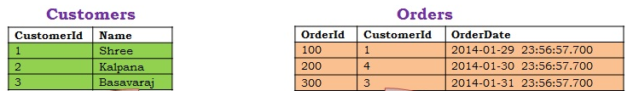
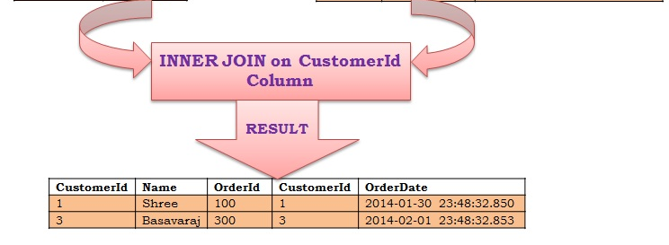
Inner Join
Result?
SELECT *
FROM Customers C
INNER JOIN Orders O
ON O.CustomerId = C.CustomerId
Syntax?
54

Slide 55
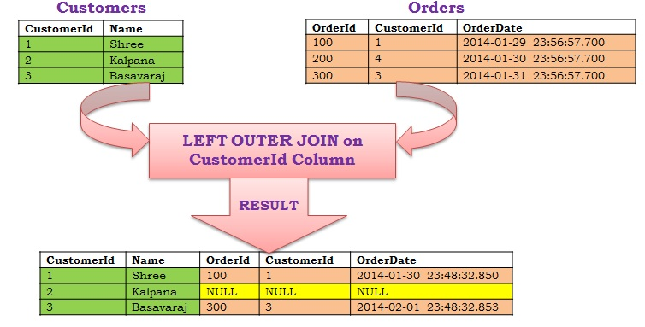
Left Outer Join
Result?
SELECT *
FROM Customers C
LEFT OUTER JOIN Orders O
ON O.CustomerId = C.CustomerId
Syntax?
55

Slide 56
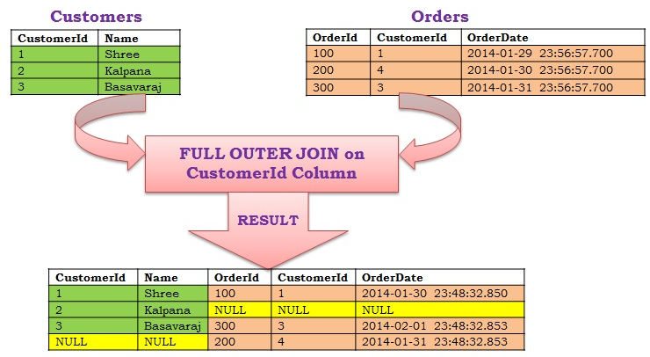
Full Outer Join
Result?
SELECT *
FROM Customers C
FULL OUTER JOIN Orders O
ON O.CustomerId = C.CustomerId
Syntax?
56

Slide 57
RDBMS Dictionary and Catalog
Data dictionary: Description of all tables in the database created by the user and designer (database designer’s database)
System catalog: System data dictionary that describes all objects within the database
Homonyms and synonyms must be avoided to lessen confusion
Homonym: Same name is used to label different attributes
Synonym: Different names are used to describe the same attribute
57

Slide 58
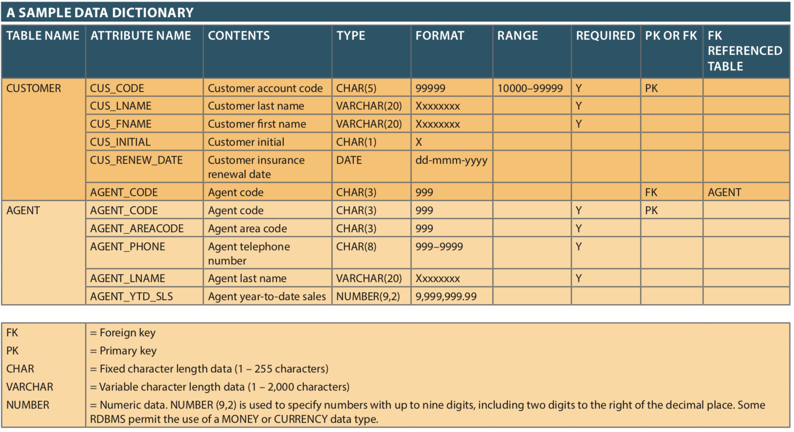
58

Slide 59
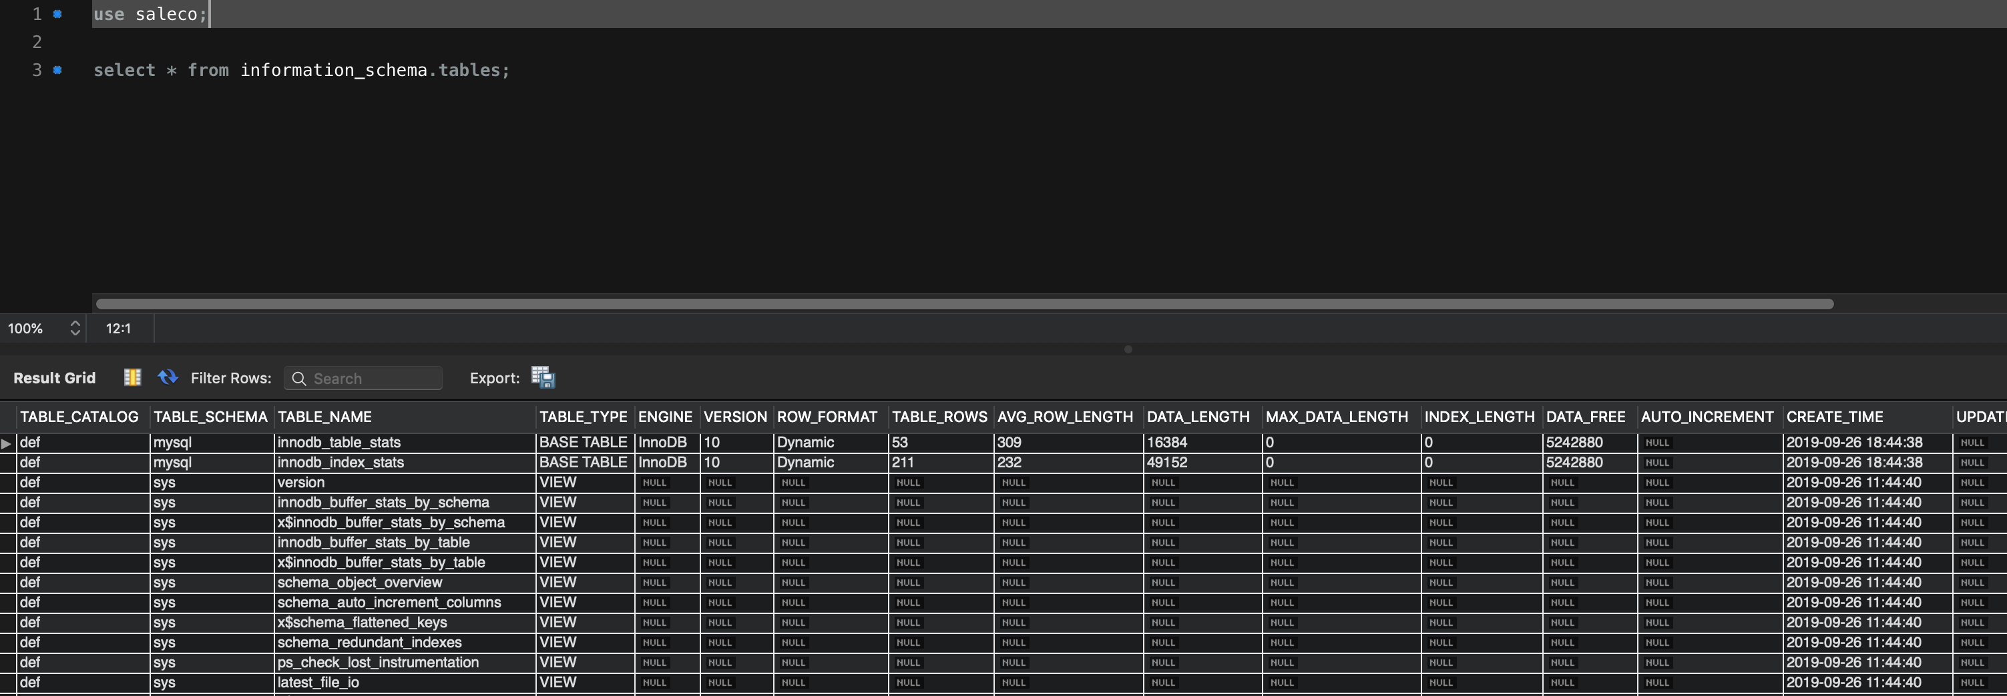
59

Slide 60
Relationships within the Relational Database
1:M relationship - Norm for relational databases
1:1 relationship - One entity can be related to only one other entity and vice versa
Many-to-many (M:N) relationship - Implemented by creating a new entity in 1:M relationships with the original entities
Composite entity (Bridge or associative entity): Helps avoid problems inherent to M:N relationships, includes the primary keys of tables to be linked
AKA Intersection Table
60

Slide 61
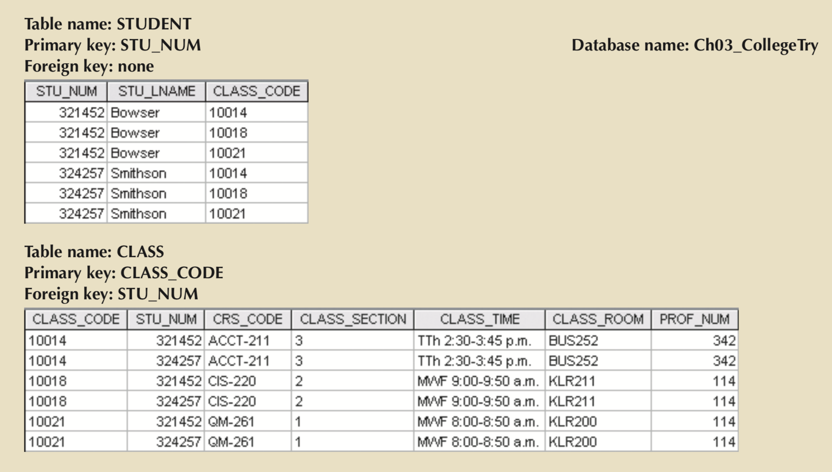
M:N Relationships

Slide 62
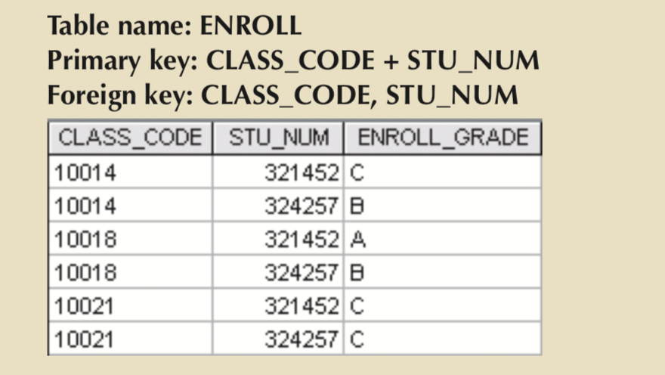
M:N Relationships
Linking Table is an implementation of an associative entity

Slide 63
MySQL
Developed in 1995 as an interface to the Indexed Sequential Access Method (ISAM) to replace mSQL
SQL engine with options for physical implementation
MyISAM -> InnoDB
MySQL Server two flavors
MySQL Community Server (open-source)
MySQL Enterprise Server (proprietary)
MySQL is used to describe both in practice, but usually the full server implementation

Slide 64
MySQL
Most broadly deployed open-source DBMS
Connectors for many programming languages and environments
Lots of tools for modification, analysis and maintenance
MySQL Workbench
phpMyAdmin

Slide 65
MySQL
Sakila
Ekho

Slide 66
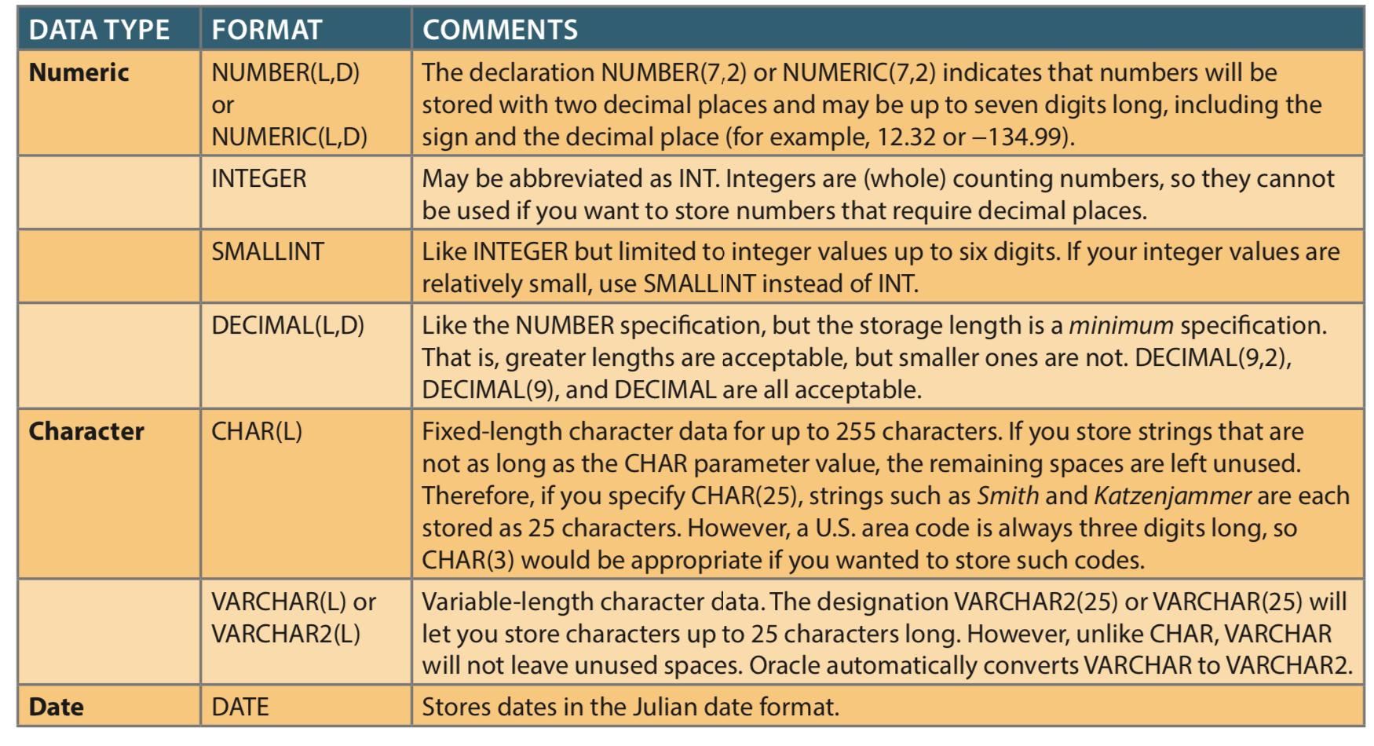

Slide 67
Numeric
NUMBER (L, D)
- L is length in digits
- D is location of decimal point, 1000.00 = ?
- used for rational quantities
INTEGER and SMALLINT
- whole numbers up to system limit (INTEGER) or six-digits (SMALLINT)
- 1234567 would need which datatype?
DECIMAL (L,D) is similar to NUMBER except it is a minimum
67

Slide 68
Strings and Dates
CHAR(L)
- string with length L
- Zipcodes = ???
- DolphinID = ???
68

Slide 69
Strings and Dates
CHAR(L)
- string with length L
- Zipcodes = CHAR(5)
- DolphinID = CHAR(9) or INTEGER
69

Slide 70
Strings and Dates
CHAR(L)
- string with length L
- Zipcodes = CHAR(5)
- DolphinID = CHAR(9) or INTEGER
VARCHAR(L)
- string with length up to L
- CHAR allocates memory for length L, VARCHAR does not
- Username should be CHAR or VARCHAR?
DATE is generally ISO standard YYYY-MM-DD HH:MM:SS
70

Slide 71
Summary
Tables are basic building blocks of a relational database
Keys are central to the use of relational tables
Keys define functional dependencies
Superkey
Candidate key
Primary key
Secondary key
Foreign key

Slide 72
Summary
Each table row must have a primary key that uniquely identifies all attributes
Tables are linked by common attributes
The relational model supports relational algebra functions
SELECT, PROJECT, JOIN, INTERSECT UNION, DIFFERENCE, PRODUCT, DIVIDE
Good design begins by identifying entities, attributes, and relationships
1:1, 1:M, M:N

Slide 73
In-Class Exercise
Download Saleco DB file from Canvas
Connect to localhost
Load Saleco DB file
Query for the number of vendors in VENDOR table
Screenshot an INNER JOIN on v_code between PRODUCT and VENDOR tables

